Slide 1
Graphing Best Practices
CSS 2 – Spring, 2022
Erik Brockbank
*content heavily borrowed from a graduate lecture by Edward Vul

Slide 2
What We’ll Cover

Slide 3
What We’ll Cover
Ways graphs can go wrong (there are more than you think…)

Slide 4
What We’ll Cover
Ways graphs can go wrong (there are more than you think…)
How to avoid these pitfalls

Slide 5
What We’ll Cover
Ways graphs can go wrong (there are more than you think…)
How to avoid these pitfalls
Choosing the right visualization

Slide 6
What We’ll Cover
Ways graphs can go wrong (there are more than you think…)
How to avoid these pitfalls
Choosing the right visualization
Notes:
The take-away from this section is that even though all of us have lots of experience making and looking at graphs, there are a surprising number of ways in which things can go a little south when it comes to visualization.

Slide 7
Graphs Gone Awry

Slide 8
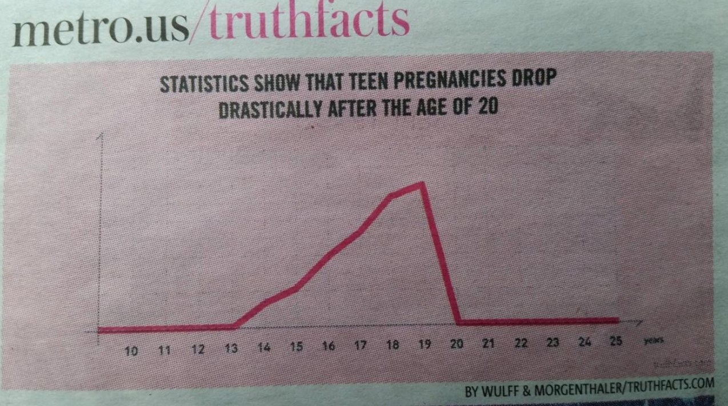
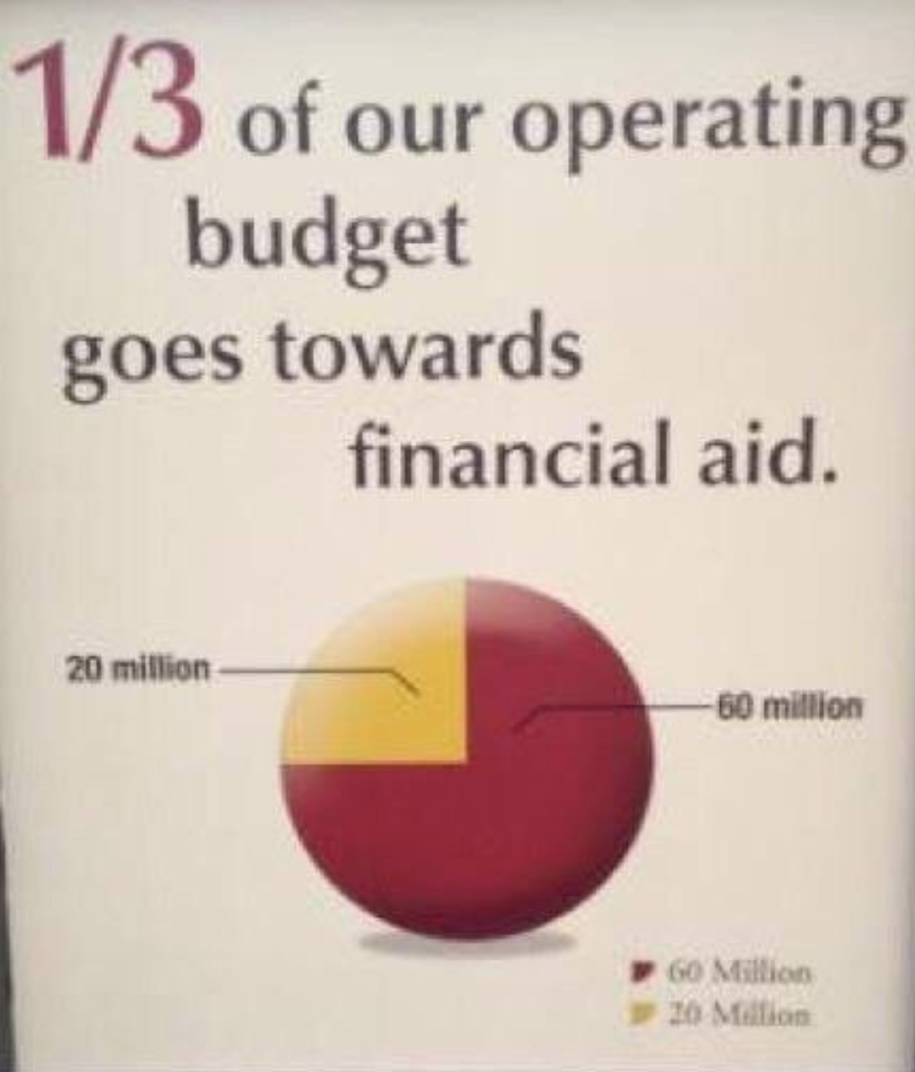
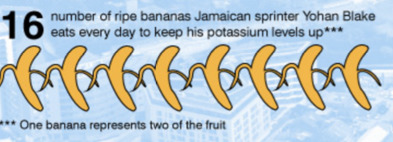
Graphs Gone Awry
Notes:
Here are some examples of what we’re talking about.
I’m going to go through some of the most common issues that arise in graphs you see out in the world.

Slide 9
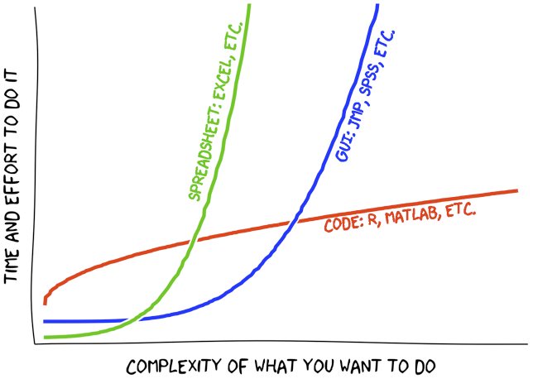
Graphs Gone Awry
Sometimes things that look like graphs are made up…
source: xkcd
Notes:
So this is a fun XKCD comic that’s meant to illustrate that coding languages (in red here) are a lot of work at first but are much better than things like excel when you need to do more complex stuff.
This obviously isn’t an actual graph because there’s no data here.
It’s fine because this is a web comic.

Slide 10
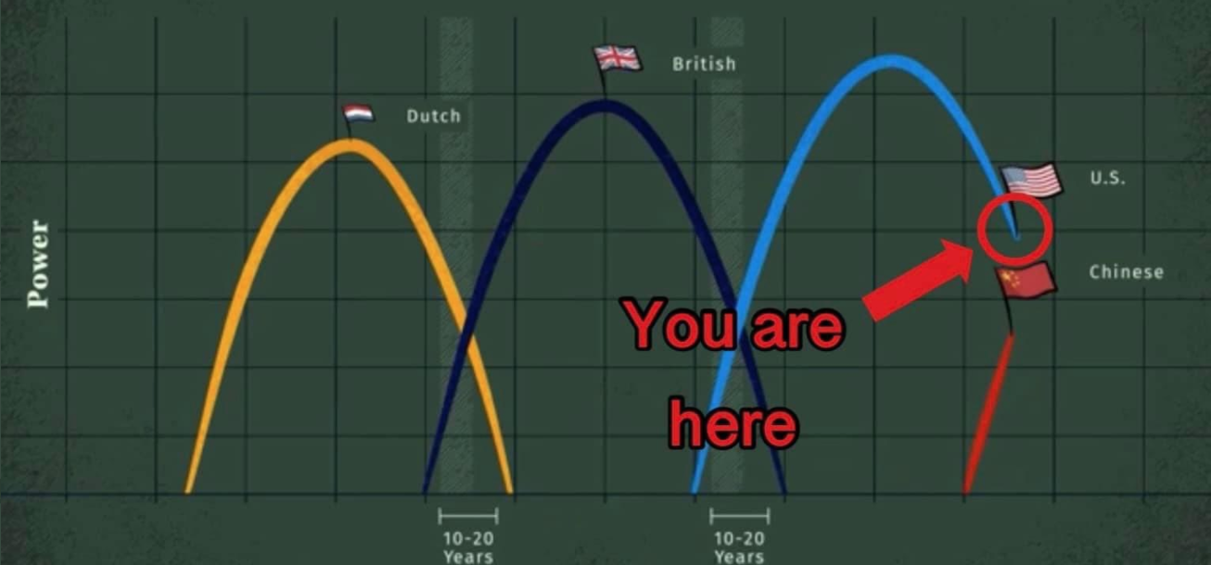
Graphs Gone Awry
Sometimes things that look like graphs are made up…
source: @GraphCrimes
Notes:
But in this case, this is a visualization that seems meant to make a point as if there were some data behind it, but this graph isn’t actually illustrating that data

Slide 11
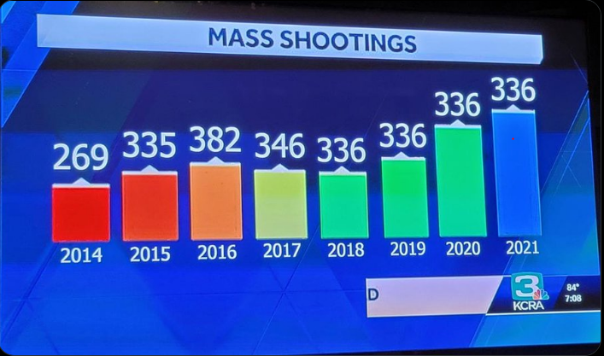
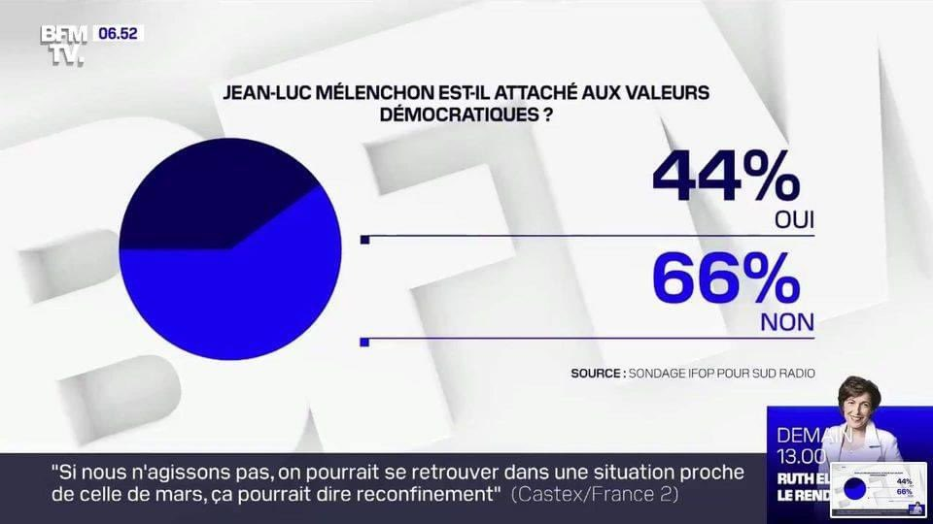
Graphs Gone Awry
Sometimes it’s a real graph but it doesn’t match the data…
Notes:
At left: 336 all the way up…
Right: we somehow have 110% of respondents here…

Slide 12
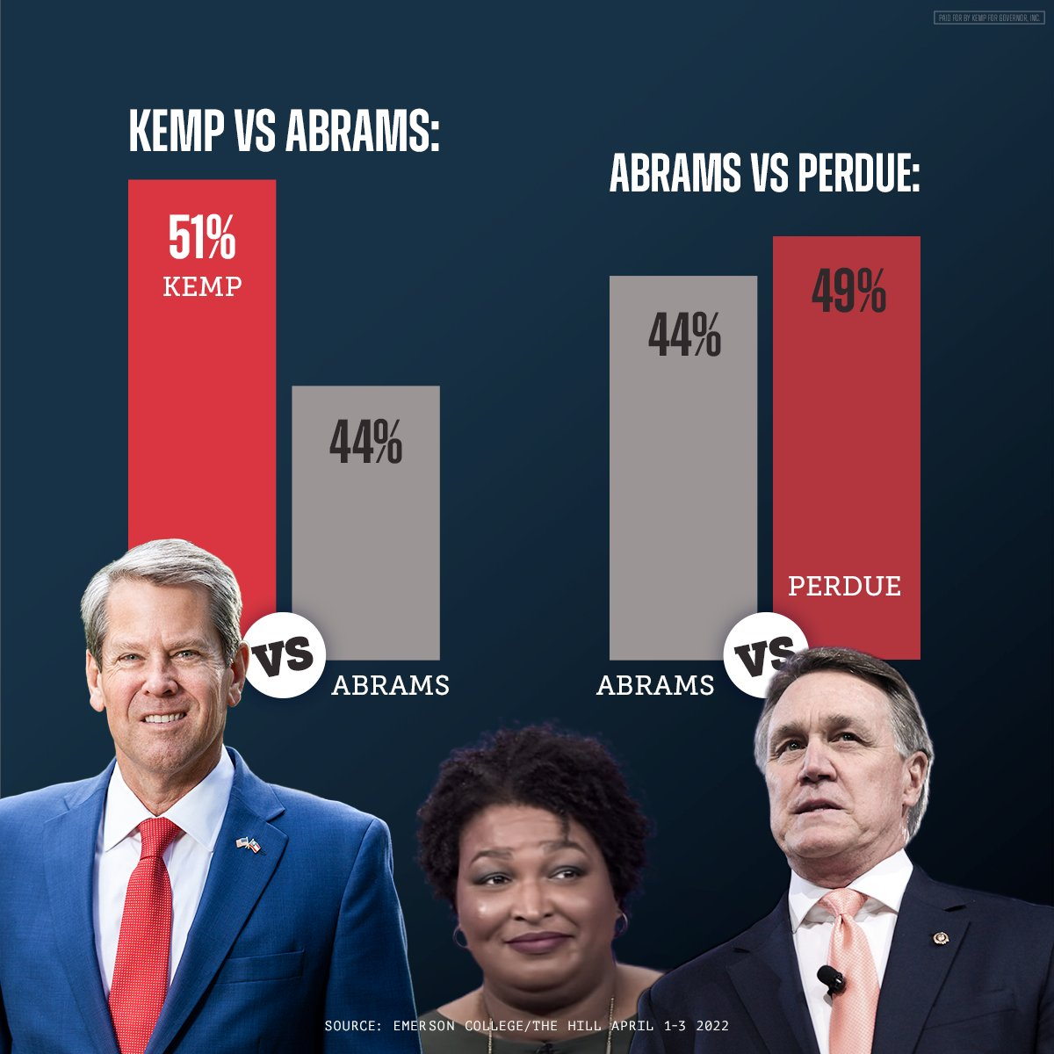
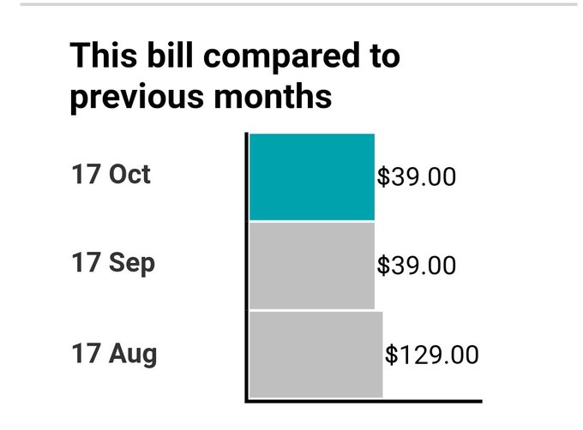
Graphs Gone Awry
Axis scales can be misleading…
Notes:
Left: 44% in two very different places
Right: just wow.

Slide 13
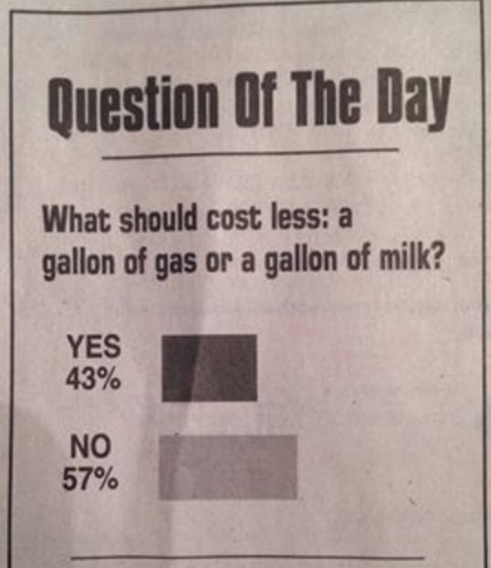
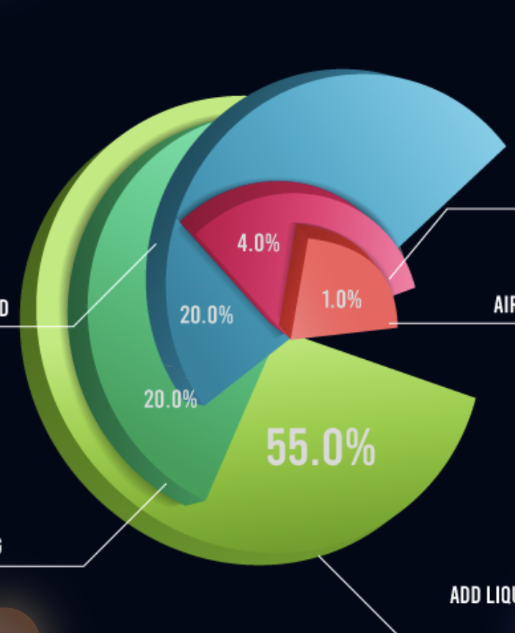
Graphs Gone Awry
…or not there at all

Slide 14
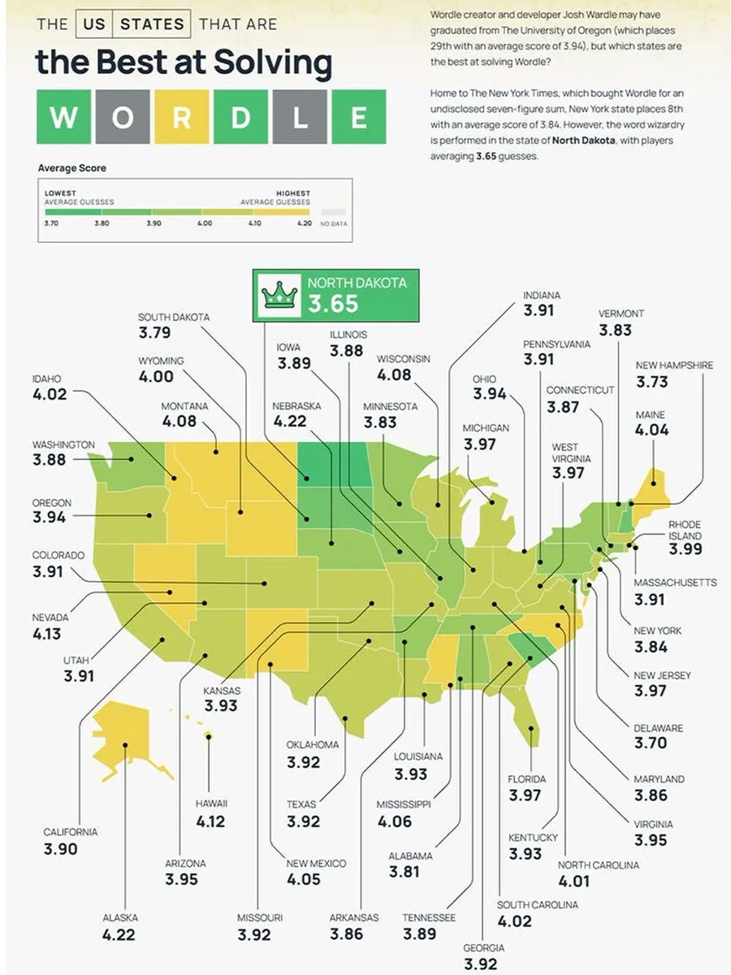
Graphs Gone Awry
Be careful of bins or gradients that are kind of useless…

Slide 15
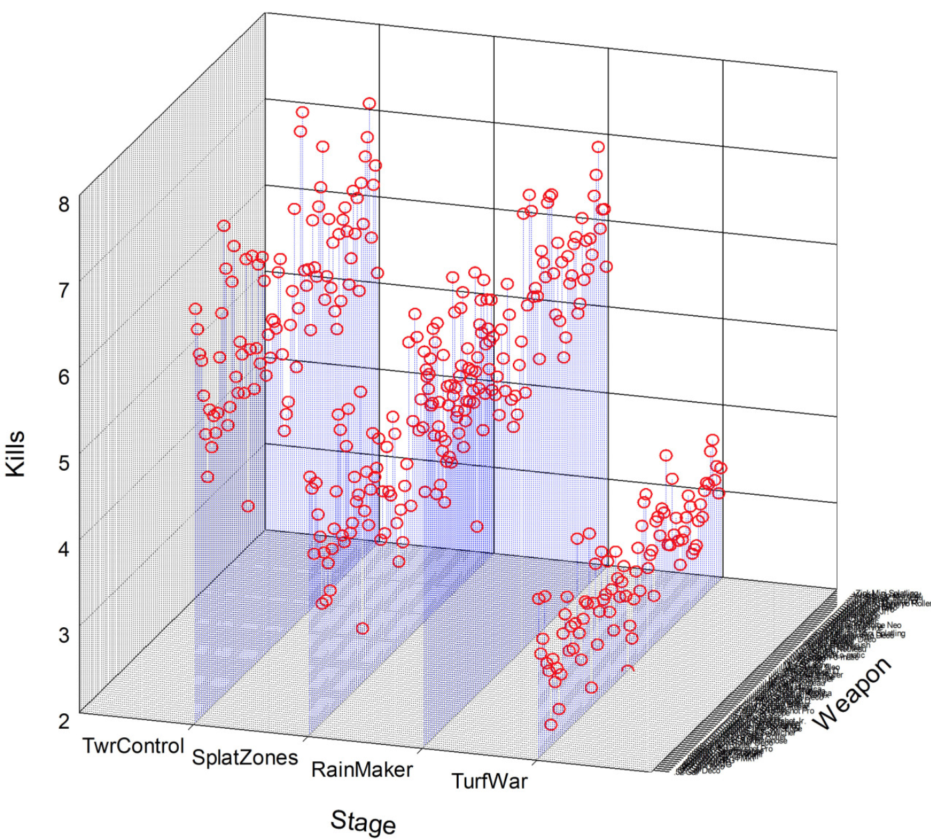
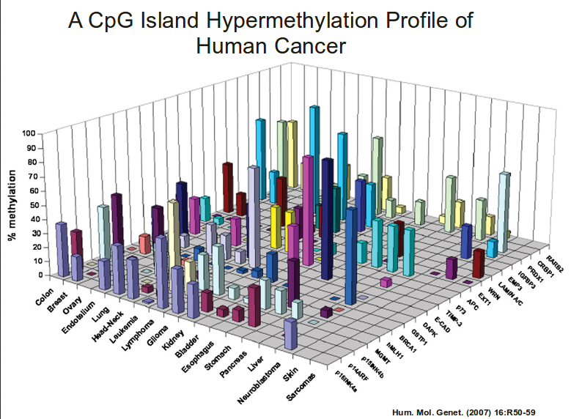
Graphs Gone Awry
Sometimes, you’ll see graphs that are mostly incomprehensible

Slide 16
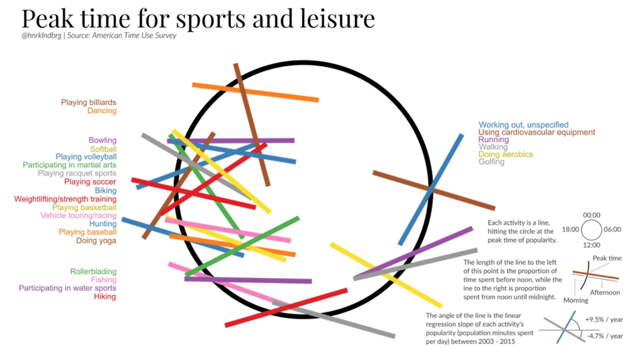
Graphs Gone Awry
Or, the relationship between the underlying data and the visual presentation is really stretched

Slide 17
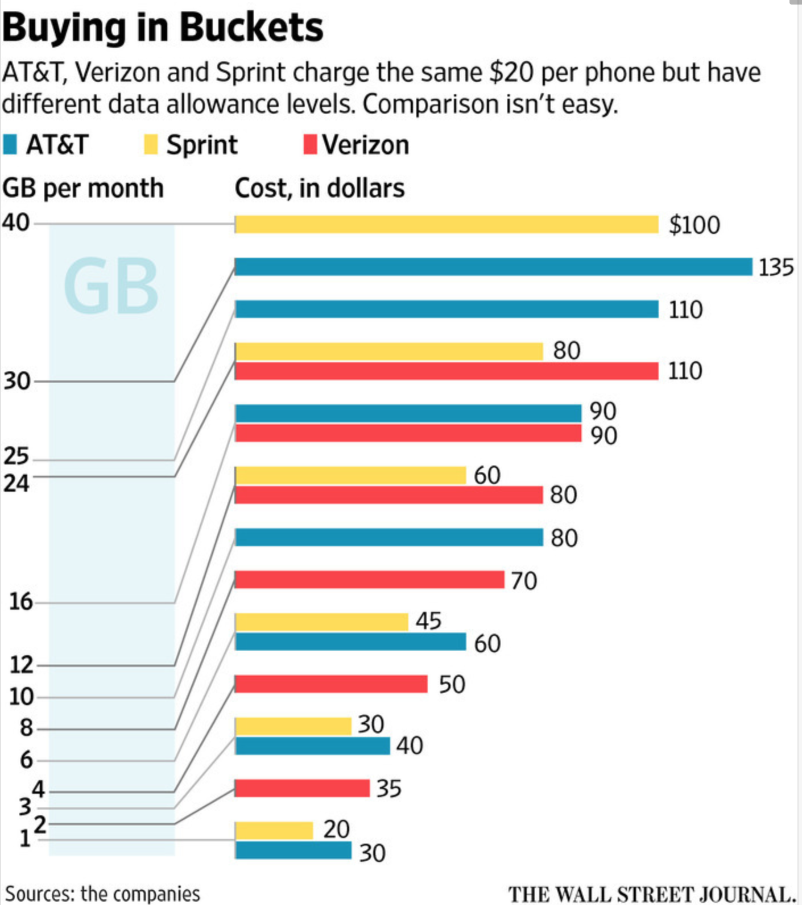
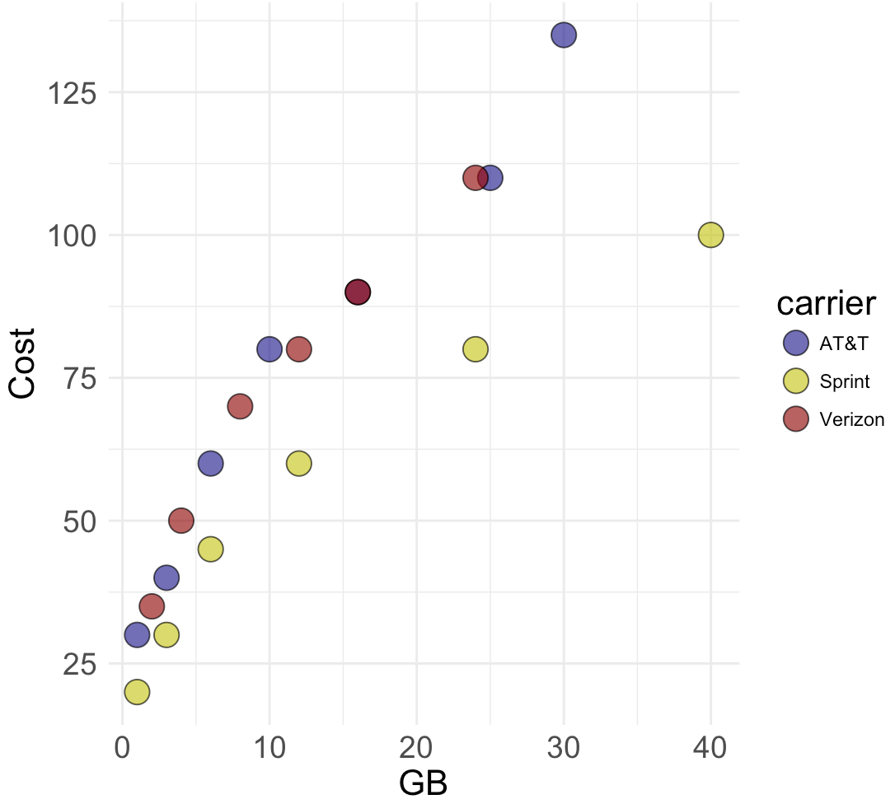
Graphs Gone Awry
Or, the relationship between the underlying data and the visual presentation is really stretched

Slide 18
Graphs Gone Awry

Slide 19
Graphs Gone Awry
In sum, there are a lot of ways graphs can go haywire.

Slide 20
Graphs Gone Awry
In sum, there are a lot of ways graphs can go haywire.
Recognizing this in the world around us is important, and avoiding it in our own work even more so!

Slide 22
What We’ll Cover
Ways graphs can go wrong (there are more than you think…)
How to avoid these pitfalls
Choosing the right visualization
Notes:
So, we’ve talked a bit about how graphs can go wrong.
I hope I’ve convinced you that this happens more often than you might think, and in a number of different ways.

Slide 23
What We’ll Cover
Ways graphs can go wrong (there are more than you think…)
How to avoid these pitfalls
Choosing the right visualization
Notes:
So now let’s talk a bit about how to avoid some of the “graph crimes” we just saw.
In this section, we’re going to go through some high level best practices.
I want to start by saying that a lot of this stuff is pretty intuitive, so you might be watching thinking, “oh yeah duh.”
But when first year grad students give their talks in psychology, this is some of the most common feedback they get.
So it’s not always easy to put these things in place when your data is complicated or messy.
Kind of like good coding practices, the sooner you start thinking about this stuff, the easier it is down the line!

Slide 24
Best Practices

Slide 25
Best Practices
Label your axes

Slide 26
Best Practices
Label your axes
Follow axis conventions

Slide 27
Best Practices
Label your axes
Follow axis conventions
→ Explanatory variable on x axis
→ Simple and intuitive y variable whenever possible

Slide 28
Best Practices
Label your axes
Follow axis conventions
→ Explanatory variable on x axis
→ Simple and intuitive y variable whenever possible
Include uncertainty (standard error, confidence intervals, or raw data itself)

Slide 29
Best Practices
Label your axes
Follow axis conventions
→ Explanatory variable on x axis
→ Simple and intuitive y variable whenever possible
Include uncertainty (standard error, confidence intervals, or raw data itself)
“Remove to improve”

Slide 30
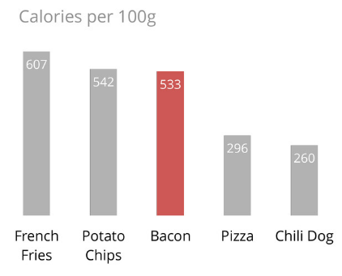
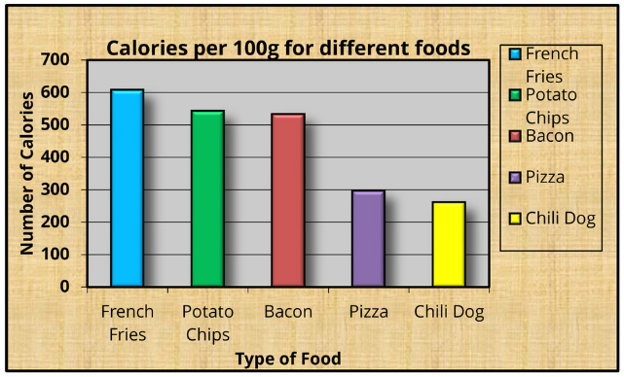
Best Practices
Source: Darkhorse Analytics

Slide 31
Best Practices
Label your axes
Follow axis conventions
→ Explanatory variable on x axis
→ Simple and intuitive y variable whenever possible
Include uncertainty (standard error, confidence intervals, or raw data itself)
“Remove to improve”
Choose the right graph for the problem

Slide 33
How to know you’re doing it right

Slide 34
How to know you’re doing it right
A viewer can easily recognize what’s in your graph

Slide 35
How to know you’re doing it right
A viewer can easily recognize what’s in your graph
→ clear axis labels and legends, remove to improve
Notes:
Key: what’s on each axis, what categories are there (if any)?

Slide 36
How to know you’re doing it right
A viewer can easily recognize what’s in your graph
→ clear axis labels and legends, remove to improve
A viewer can easily make the sorts of comparisons you want them to or identify the pattern you’re trying to express

Slide 37
How to know you’re doing it right
A viewer can easily recognize what’s in your graph
→ clear axis labels and legends, remove to improve
A viewer can easily make the sorts of comparisons you want them to or identify the pattern you’re trying to express
→ remove to improve, choose the right graph
Notes:
Are we comparing categories? Are we looking for linear patterns? The graph should make this obvious

Slide 38
How to know you’re doing it right
A viewer can easily recognize what’s in your graph
→ clear axis labels and legends, remove to improve
A viewer can easily make the sorts of comparisons you want them to or identify the pattern you’re trying to express
→ remove to improve, choose the right graph
A viewer can easily figure out what the “point” of the graph is (i.e., what is the key result or finding; don’t overdo it!)
Notes:
Sort of related to the point above.
Most graphs should have 1-2 main “ideas” or points they’re trying to make.

Slide 39
How to know you’re doing it right
A viewer can easily recognize what’s in your graph
→ clear axis labels and legends, remove to improve
A viewer can easily make the sorts of comparisons you want them to or identify the pattern you’re trying to express
→ remove to improve, choose the right graph
A viewer can easily figure out what the “point” of the graph is (i.e., what is the key result or finding; don’t overdo it!)
→ Remove to improve, choose the right graph

Slide 40
How to know you’re doing it right
A viewer can easily recognize what’s in your graph
→ clear axis labels and legends, remove to improve
A viewer can easily make the sorts of comparisons you want them to or identify the pattern you’re trying to express
→ remove to improve, choose the right graph
A viewer can easily figure out what the “point” of the graph is (i.e., what is the key result or finding; don’t overdo it!)
→ Remove to improve, choose the right graph
A viewer can do all the above with the right level of precision or certainty

Slide 41
How to know you’re doing it right
A viewer can easily recognize what’s in your graph
→ clear axis labels and legends, remove to improve
A viewer can easily make the sorts of comparisons you want them to or identify the pattern you’re trying to express
→ remove to improve, choose the right graph
A viewer can easily figure out what the “point” of the graph is (i.e., what is the key result or finding; don’t overdo it!)
→ Remove to improve, choose the right graph
A viewer can do all the above with the right level of precision or certainty
→ Uncertainty or raw data
Notes:
Is this a super strong conclusion? Or is it a little fuzzy?

Slide 43
What We’ll Cover
Ways graphs can go wrong (there are more than you think…)
How to avoid these pitfalls
Choosing the right visualization

Slide 44
What We’ll Cover
Ways graphs can go wrong (there are more than you think…)
How to avoid these pitfalls
Choosing the right visualization

Slide 45
Choosing the right graph for the job

Slide 46
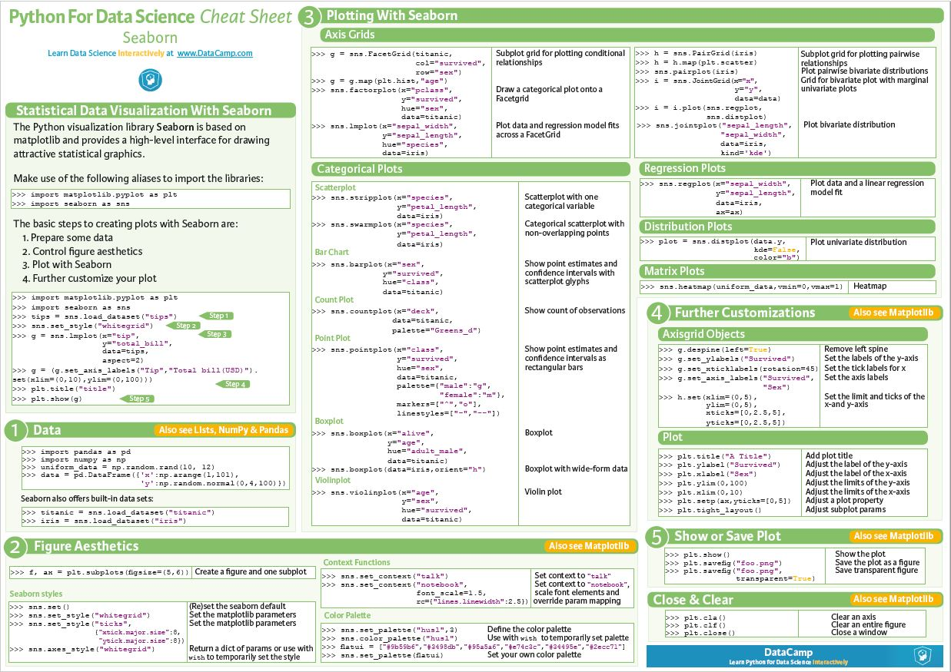
Choosing the right graph for the job
Source:
https://www.kaggle.com/getting-started/126958

Slide 47
Choosing the right graph for the job
What kind of variables are we working with?
Categorical / discrete
Numerical / continuous
Which variable(s) are explanatory and which are being explained (response variable)?

Slide 48
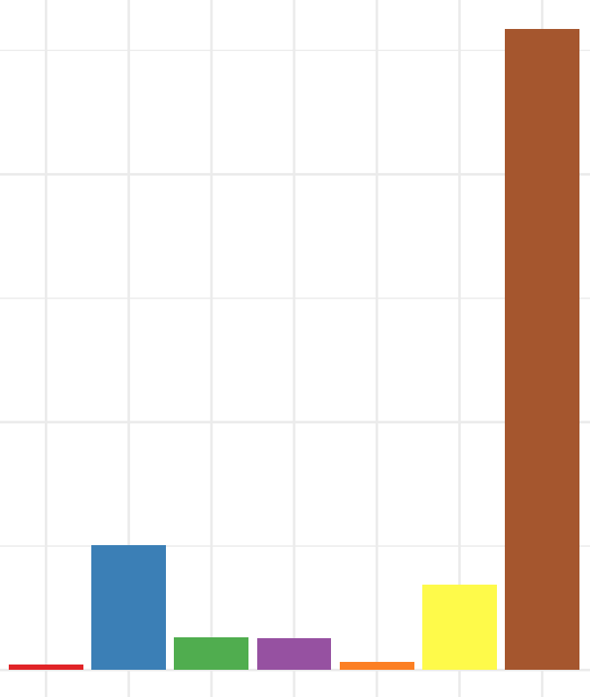
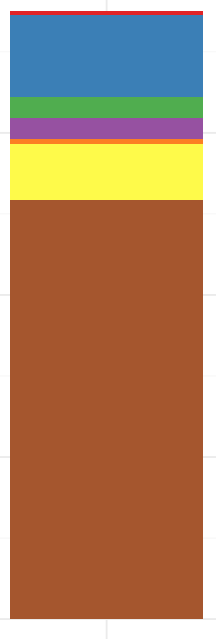
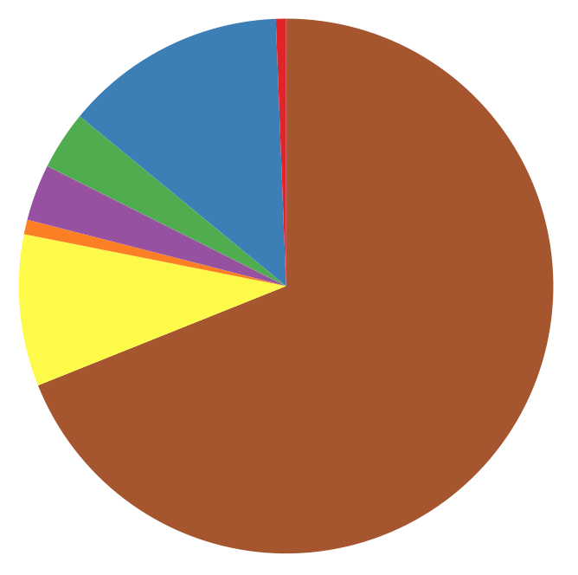
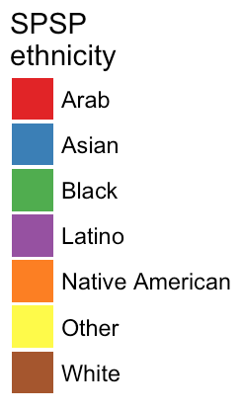
Choosing the right graph for the job
Categorical response variable, no explanatory variable
Pie chart
Stacked barplot
Histogram barplot
(counts or proportions)
Data: http://vulstats.ucsd.edu/data/spsp.demographics.cleaned.csv

Slide 49
Choosing the right graph for the job
Categorical response variable, no explanatory variable
Pie chart
Stacked barplot
Histogram barplot
(counts or proportions)
Data: http://vulstats.ucsd.edu/data/spsp.demographics.cleaned.csv

Slide 50
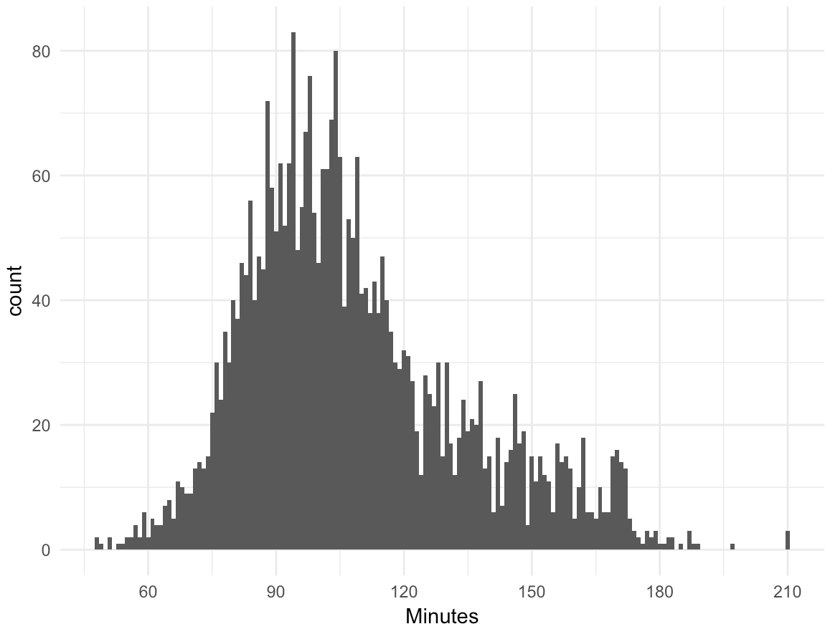
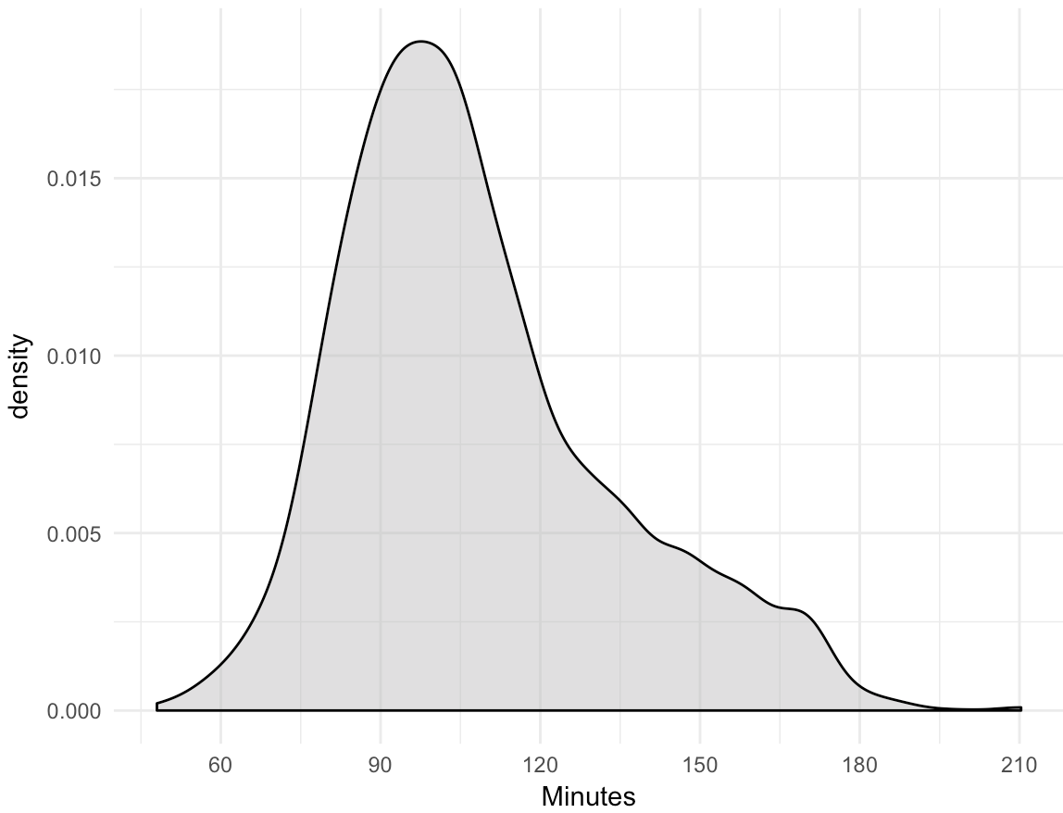
Choosing the right graph for the job
Numerical response variable, no explanatory variable
Histogram!
Smoothed density
Data: http://vulstats.ucsd.edu/data/cal1020.cleaned.Rdata

Slide 51
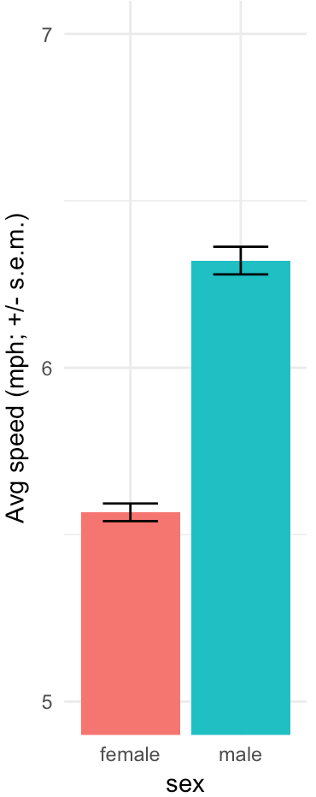
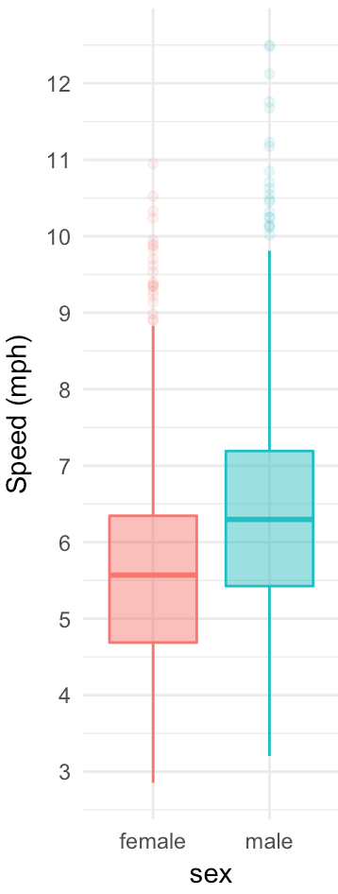
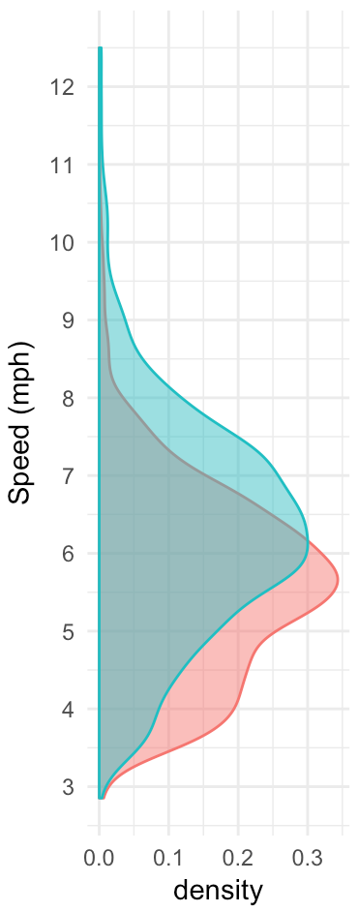
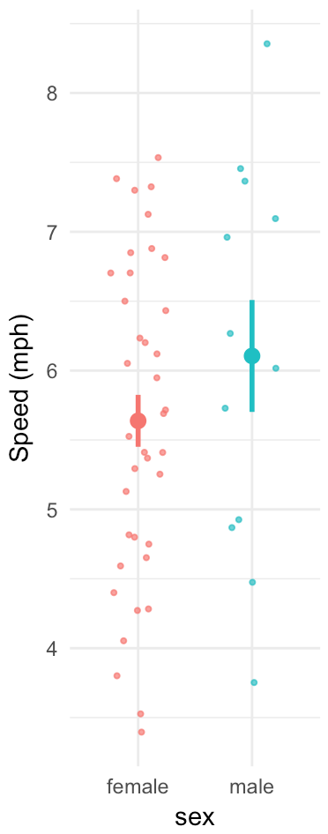
Choosing the right graph for the job
Numerical response variable, categorical explanatory variable
Densities (or histograms)
Mean + error
Boxplot
Data: http://vulstats.ucsd.edu/data/cal1020.cleaned.Rdata
Notes:
These are increasing in terms of how much you show people the underlying data versus just the summaries.
At far right, we get the best of both worlds.

Slide 52
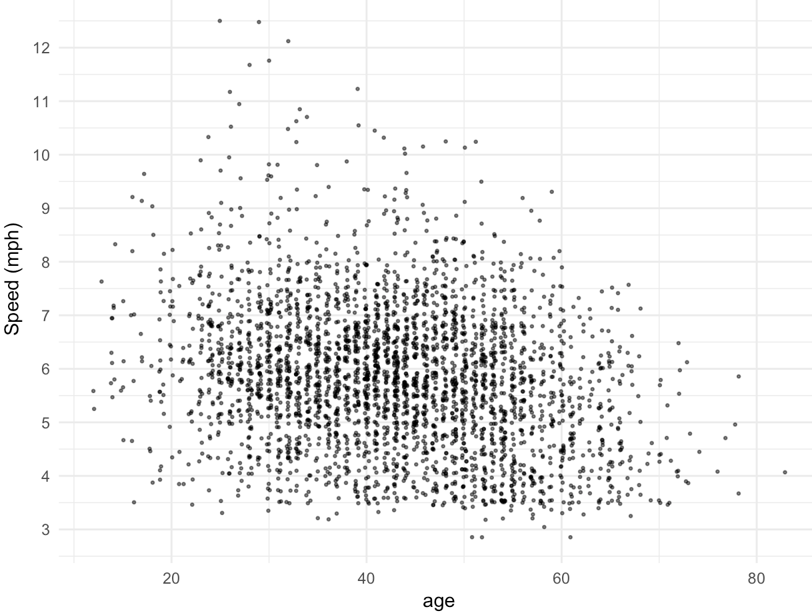
Choosing the right graph for the job
Numerical response variable, numerical explanatory variable
Scatterplot
Data: http://vulstats.ucsd.edu/data/cal1020.cleaned.Rdata

Slide 53
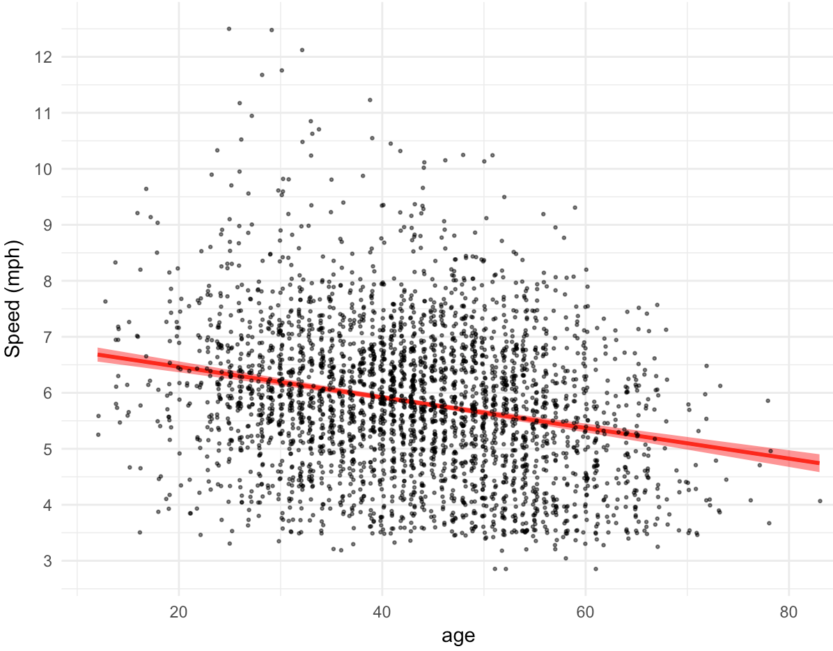
Choosing the right graph for the job
Numerical response variable, numerical explanatory variable
Include line of best fit!
Data: http://vulstats.ucsd.edu/data/cal1020.cleaned.Rdata

Slide 54
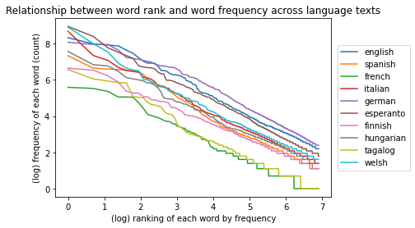
Choosing the right graph for the job
Numerical response variable, numerical and categorical explanatory variables
More options here, but this is usually a good start!

Slide 55
Choosing the right graph for the job
This obviously isn’t everything when it comes to visualization options
But this should get you on the right path most of the time!

Slide 57
What We’ll Cover
Ways graphs can go wrong (there are more than you think…)
How to avoid these pitfalls
Choosing the right visualization

